Slide 1
Nucleic acid hybridization on an electrically reconfigurable network of gold-coated magnetic nanoparticles enables microRNA detection in blood
March 7, 2022
Chunlin Min

Slide 2
Outline
Background
Voltammetry
MicroRNA and miR-21
Paper Introduction
DNA-Au@MNP
Procedure
Range of detection & selectivity
Detection Mechanism
Examining capability of sensor
Conclusion
Opinions

Slide 3
Background

Slide 4
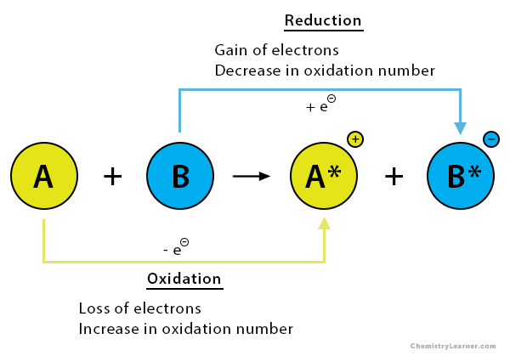
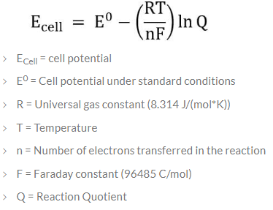
Voltammetry
Voltammetry
Electroanalytical method based on study of current as a function of applied voltage to obtain information about an analyte
Studies oxidation-reduction (redox) reactions
Based on Nernst equation
relates cell potential and redox product/reactant concentrations

Slide 5
Voltammetry: How does it work?
By Nernst equation, if the cell potential is changed then to balance the equation, Q must change as well
System is disturbed, redox reaction is forced to occur
Current is measured at the working electrode
Current magnitude is proportional to applied voltage and analyte concentration

Slide 6
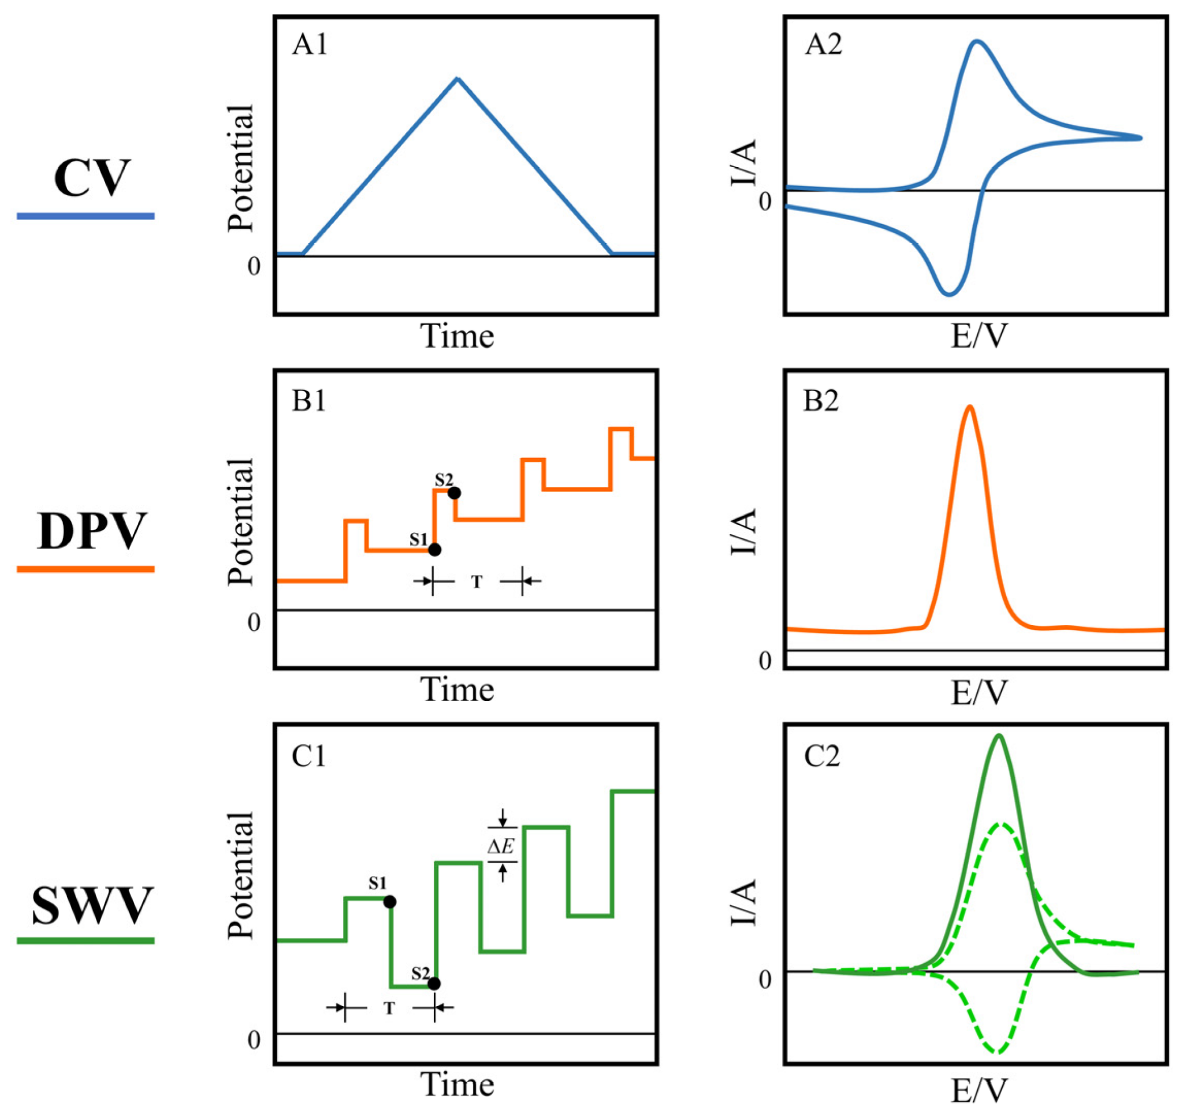
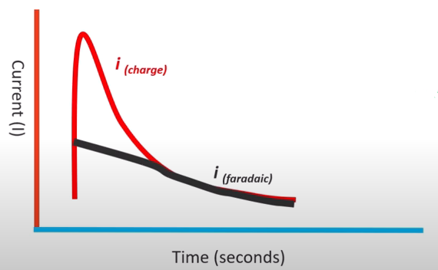
Types of Voltammetry
Cyclic voltammetry (CV)
Square wave voltammetry (SWV)
Differential pulse voltammetry (DPV)
One challenge is to measure the Faradic current and distinguish it from capacitive current
Notes:
You can have different methods of varying the cell potential. The left columns shows the waveforms of potential as function of time for CV, DPV, and SWV. The right columns show the respective voltammograms, which are measured current responses to the applied potentials.
A challenge in voltammetry is to isolated the Faradic current from background/capacitive current. Faradic current is related to electrochemical reaction, while background current is due to movement of ions in the electrolyte. There are two general mechanisms to tackle this challenge. Either you wait for the capacitive current to dissipate before taking measurement, or you try to subtract away the background current. CV uses the waiting mechanism. DPV and SWV uses both waiting and subtraction. Thus, DPV and SWV are generally more sensitive and appropriate for low concentrations of analyte.

Slide 7
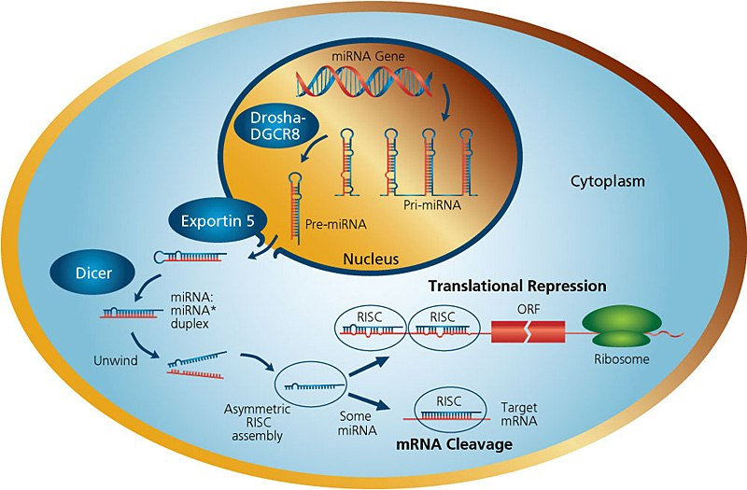
MicroRNA
microRNAs (miRNAs) are small sequences, ~21 nucleotides long, of non-coding RNA that help regulate gene expressions
Stable in bodily fluids, which is a good characteristic for a biomarker
A single miRNA can bind to several or hundreds of target mRNAs
Dysregulation or abnormal levels of miRNA may lead to cancer, heart diseases
Achieves gene silencing functionality when associated with RNA-induced silencing complex (RISC)
Gene silencing mechanism is selected based on the level of complementarity with target mRNA
can be cleavage of target mRNA or translation repression
Notes:
YouTube video “Gene Silencing by microRNA” https://youtu.be/t5jroSCBBwk

Slide 8
MicroRNA-21
MicroRNA-21 (miR-21) is a popular biomarker in studies
Linked to at least 29 cancer and non-cancerous diseases [1]
Usually found to be upregulated or highly expressed in cancer
Plays a role in cell proliferation, migration, invasion and apoptosis
miR-21 can be found in most cell types

Slide 9
Paper

Slide 10
Introduction
Immense interest in quantifying microRNA across broad ranges and in ultra low amounts using direct analysis from whole blood
Important diagnosis and prognosis values
Early detection of cancer, monitor disease progression, etc
This paper presents a method using a network of gold coated magnetic nanoparticles (Au@MNP) modified with probe DNA (DNA-Au@MNP) to detect concentrations of microRNA from 10 aM to 1 nM in unprocessed blood samples

Slide 11
DNA-Au@MNP
Magnetic properly allows the nano sensor to seek out analyte (dispersible electrodes) rather than waiting for analyte to diffuse to the sensor
Increases sensitivity and deduces diffusion wait time (especially for low analyte concentration)
Reported in a previous study to have over 1000 times improvement in detection limit and response time compared to conventional gold macroelectrode surface
Fabrication of Au@MNP is described in a paper from 2009
Fabrication and Dispersion of Gold-Shell-Protected Magnetite Nanoparticles: Systematic Control Using Polyethyleneimine [2]
Surfaces of Au@MNP were modified with a probe DNA complementary to target miR-21
Prove DNA has thiol modification at one end and methylene blue redox label at the other
Probe DNA: 5′-SH-(CH2)3-p-TCAACATCAGTCTGATAAGCTA-(CH2)3-MB-3′
Complementary RNA target (miRNA-21): 5′-UAGCUUAUCAGACUGAUGUUGA-3′
Notes:
To start off, I will talk a bit about the nano sensor itself.
The magnetic property of the sensor allows it to seek out analyte rather than waiting for analyte to diffuse to the electrode surface. In a previous study, it was found that the performance of dispersible electrode is over 1000 times better than conventional gold macroelectrode.
The fabrication of the sensor is covered in another paper, I won’t go into that.
The surface of the sensor is modified by a DNA probe for the target analyte. One end of the DNA has a thiol modification to bond covalently with sensor surface. The other end of the DNA is modified with methylene blue redox label.

Slide 12
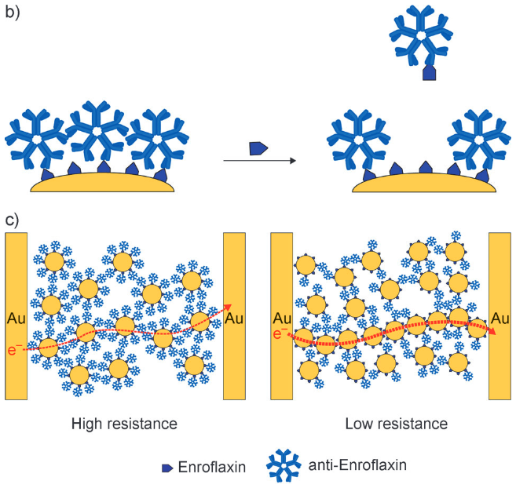
Au@MNPs property as a Biochemiresistor
First introduced in “The biochemiresistor: an ultrasensitive biosensor for small organic molecules” [3]
Example from [3] (diagram)
(b) Ab-Au@MNP surface is modified with anti-enrofloxacin antibody
When target is enrofloxacin is present in solution, surface anti-enrofloxacin can dissociate from surface bound enrofloxacin
(c) Higher target concentration => lower resistance
Notes:
One important property of the nano sensor is the biochemiresistor.
This property was covered in a different paper, but I will briefly explain it here since its relevant to the understanding of this paper.
If you take a look at the diagram. In the top left image, we see the surface of the nano particle modified with enroflaxin attached to their antibody. These nano particles are then dispersed in sample containing the analyte, which is enroflaxin.
Top right image shows that the antibodies, which were originally bounded to the nano particles, can dissociate from the particle surface and bind to enroflaxin in the sample solution.
After some incubation time, the nano particles are collected magnetically between two electrode films and dissociated antibodies are washed away.
For a low concentration of the analyte, you would get more of the antibodies still attached to the nano sensors, resulting in increased distances between particles, which means high resistance between the two electrode sheets. This is what you see in the bottom left image.
Bottom right image shows the case for a high concentration of analyte.
In summary, biochemiresistor property of gold coated magnetic nano particles is based on this kind of displacement concept, where interaction between analyte and probe changes the distance between nano particles, thus affecting its electrical properties when collected to take measurements.

Slide 13
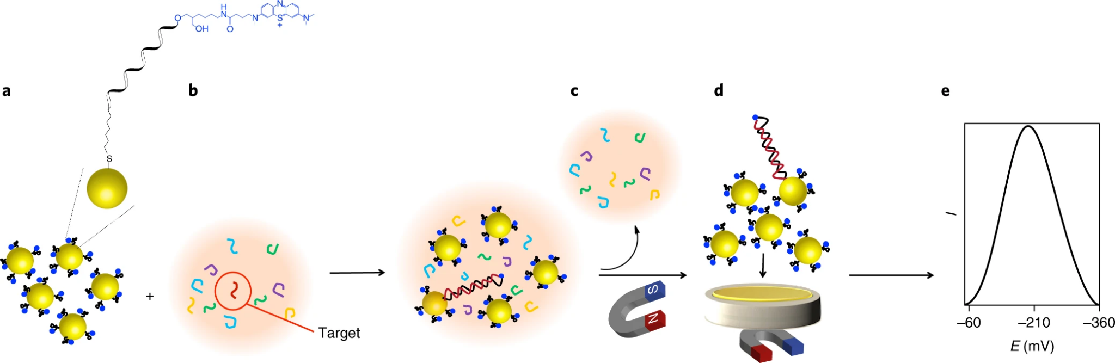
Procedure
DNA-Au@MNPs are incubated for 30 min with 2 mL of target miRNA solution while gentle mixing in the rotating wheel
DNA-Au@MNPs are then collected magnetically onto gold microelectrode and unhybridized targets are washed away
Apply 10 cycles of square-wave voltammetry in the potential range between 200 and −500 mV with pulse amplitude of 20 mV and frequency of 2 Hz
Compare peak of voltammogram to calibration curve to determine concentration of target
Notes:
The procedure for the assay introduced by the paper is as follows:
First, nano sensors with surface modified DNA probes are mixed with sample containing the analyte for 30 mins in a rotating wheel.
Then, the nano sensors are collected magnetically on to electrode surface, and you do some washing to clear away everything else.
After that, you apply square wave voltammetry to obtain a voltammogram. You measure the peak current in the voltammogram, compare it to the calibration curve and determine concentration of the analyte.

Slide 14
Assembly
Custom-made glass electrochemical cell
Gold foil (working electrode) attached to aluminum foil is placed on the bottom of the cell on top of a plastic layer
Gold foil is cleaned electrochemically in 0.05 M sulfuric acid until a reproducible cyclic voltammogram is seen
Working electrode area was estimated using reduction peak
Measurements taken at room temperature
A neodymium disc magnet was placed for 5 mins under gold foil to collect nanoparticles
For electrochemical measurements, the magnet was removed and reference (Ag|AgCl, 3.0 M NaCl) and counter (custom-made platinum flag) electrodes were introduced into the cell

Slide 15
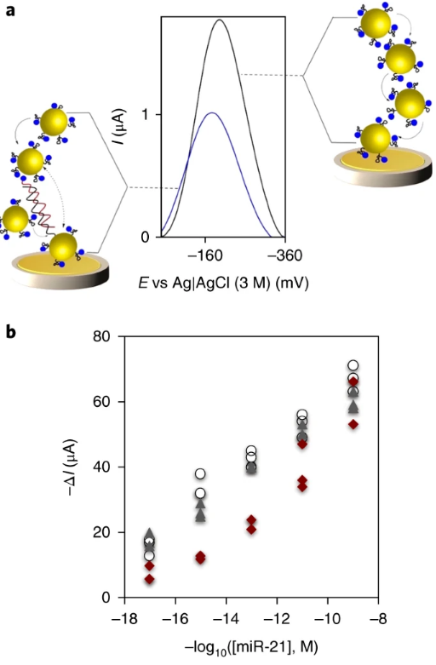
Range of Detection
Hybridization induced change in SWV peak current in three different matrixes spiked with different concentrations of target (10 aM to 1 nM)
Matrixes:
(red) 50% human blood
(grey) human serum
(white) PBS, Phosphate-buffered saline
Data collected from 50 independent experiments
Limit of detection is 10 aM
Note: Ignore the negative sign in-front of the log function for the x-axis
Notes:
To test the range of detection and to drive the calibration curve, experiments were done on three different matrixes spiked with different analyte concentrations ranging from 10 aM to 1 nM.
The signal measured was the peak current difference before and after exposing sensors to the analyte samples. An example is shown in the top figure. The concentration was plotted against the difference between the two peaks.
You can see that in the calibration curve, red markers are samples measured in human blood, grey markers are measurements in human serum, white are measurements in PBS, which is an electrolyte properties similar to blood (like ion concentration and osmolality (solute concentration))
You can see that the data measured in different matrixes are generally in agreement with each other and there is a nice linear relationship on the logarithmic scale.
The limit of detection for the assay is 10 aM
--------------
Diagram (a) Square-wave voltammograms (frequency 2 Hz, pulse amplitude 20 mV) obtained before and after exposure of the sensor to 1 pM synthetic miR-21 solution
Diagram (b) calibration graph for target concentration in different matrixes

Slide 16
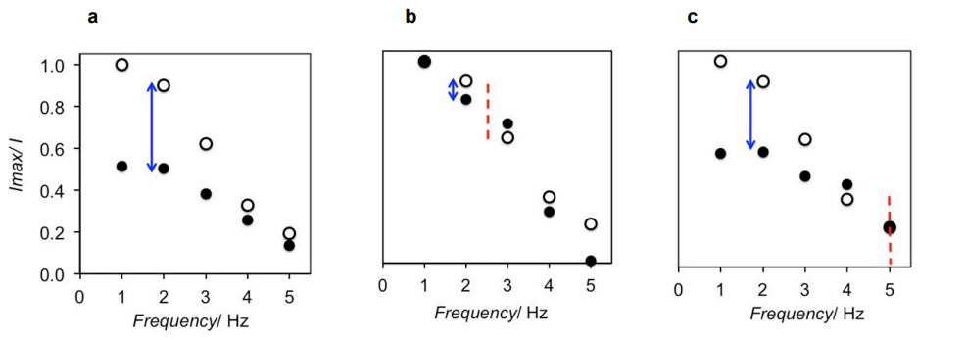
Selectivity
Diagram: change in peak current for (a) complementary targets, (b) non-complementary targets, (c) targets with single mismatch at middle position
Average 9% less of change in current for single mismatch sample compared to fully complementary sample
Ability of assay to discriminate target from related sequence
Notes:
The paper briefly went over the selectivity of the assay.
Here we have data from current measurements on different kinds of targets. (a) is the data for complementary targets. (b) is for non-complementary targets. (c) is for targets with single base pair mismatch in the middle position.
White dots are measurements when there is no hybridization on the DNA probes of the sensors. Black dots are the measurements after hybridizing with the target.
We see that at 2 Hz, there is highest current change for fully complementary targets. 9% less change for single mismatch targets, and very small change for non-complementary targets.
Just a side note: 2 Hz was selected as the optimal frequency for voltammetry based on current differences between these three kinds of target.

Slide 17
Detection Mechanism
Two hypothesis on why the sensor has low limit of detection
(1) Recap on “biochemiresistor” property of Au@MNP: hybridized probes create distance between Au@MNPs, therefore increasing path resistance or decreasing current. A limited amount of hybridized probes is enough to suppress the electrical signal of the network
(2) Electric field induced reconfiguration of the Au@MNP network redirects hybridized particles closer to electrode surface, which helps to amplify signal suppression
Notes:
There are two hypothesis on the detection mechanism.
First hypothesis is based on the biochemiresistor property of the nano sensors. Hybridized probes are less elastic; thus, they are able to create more distance between each nano particles compared to un-hybridized DNA probes.
Second hypothesis is that electric field introduced during voltammetry may have reconfigured the nano particle network by moving hybridized particles closer to electrode surface, resulting in amplified signal suppression.

Slide 18
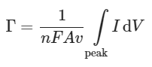
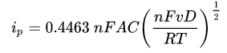
Evaluating Hypothesis 1
Area under peaks in CV helps estimate number of electrochemically-detectable redox-active molecules (amount of detectable DNA probes)
Paper used oxidation peak
n is number of electron transferred per redox event (n = 2 for MB)
F is Faraday’s constant
A is area of electrode area
v is the sweep rate
(1) Randles–Sevcik equation
(2) Estimate amount of DNA probes
Notes:
To evaluate the first hypothesis, the area under cyclic voltammogram was taken to estimate the number of detectable DNA probes.
The paper used equation 2 for the estimation. F is Faraday’s constant, A is the active area of electrode surface, v is the scan rate of cyclic voltammetry, n is the number of electron transfer per redox event.
I also put equation 1 here because I believe equation 2 is derived from the Randles-Sevcik equation, which characterises the peak current in cyclic voltammogram. But this is based off of my understanding.

Slide 19
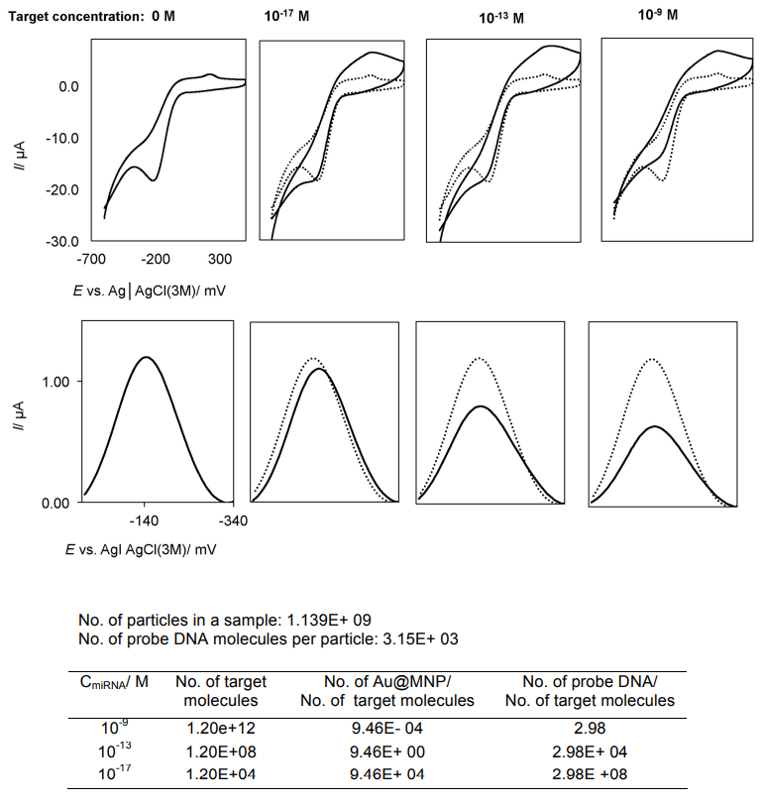
Evaluating Hypothesis 1 (Cont.)
Based on experiments with miR-21 spiked in PBS
Formation of a single double helix can “switch off” around 100,000 unhybridized Au@MNPs at 10 aM of miR-21
 | Concentration of target
 | 10 aM | 0.1 pM | 1 nM
% decrease in detectable redox-active molecules | 18.5 ± 2.6 | 23.0 ± 3.8 | 30.0 ± 4.1
Notes:
Data from experiments are shown here on the left. Data comes from varying concentrations of the analyte. First row of diagrams are cyclic voltammograms. Second row of diagrams are square wave voltammograms.
We see that with increasing analyte concentration, there are smaller peaks in SWV and a decrease in the percentage of detectable redox-active molecules. Based on some calculations, details unspecified in the paper, formation of a single double helix can switch off 100, 000 nano particles at 10 aM of miR-21

Slide 20
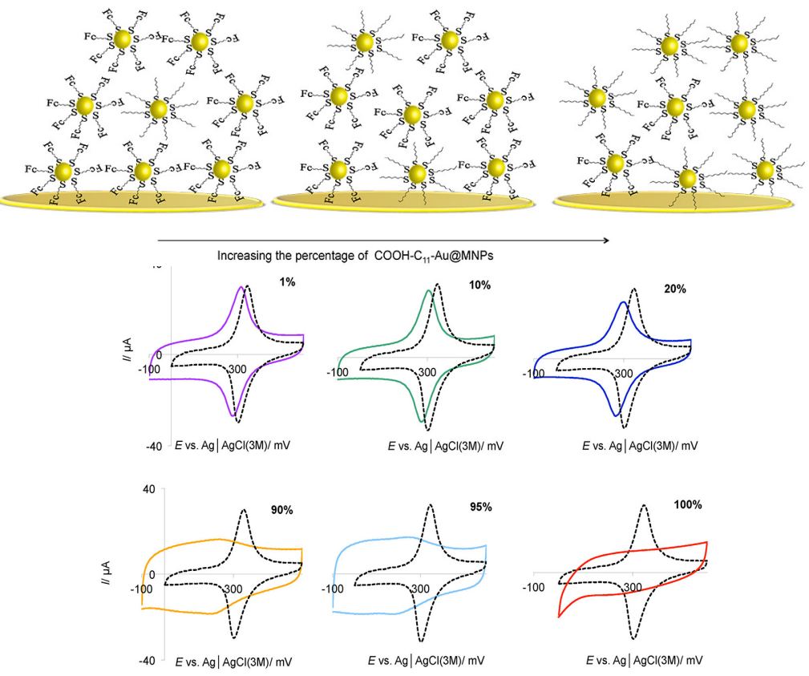
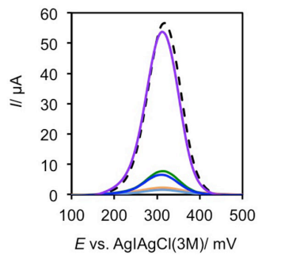
Evaluating Hypothesis 1 (Cont.)
To evaluate generality of first mechanism, 6-(ferrocenyl)hexanethiol and 1-mercaptoundecanoic acid were used to replace the DNA surface modifications
6-(ferrocenyl)hexanethiol (FHT) modified particles are electro-active
1-mercaptoundecanoic acid (MUA) modified particles act as insulators, analogous to double helix formation
Results support hypothesis that long enough molecules on surface of Au@MNP impede electron tunneling through a network of Au@MNPs
Increasing percentage of insulating nano-particle in sample
Notes:
The paper tested hypothesis 1 again with different surface modifications of the nano-particle to test the generality of the hypothesis.
FHT modified particles are electro-active. These particles are analogous to unhybridized particles.
MUA modified particles act as insulators, which are analogous to hybridized particles in previous experiments.
If it found that by replacing just 1% of FHT with insulating particles, lower levels of peak current was observed. And they increased the percentage of insulating particles and observed consistent drop in current levels.
Results are in agreement with hypothesis 1 that long enough molecules can increase resistance in the nano particle network

Slide 21
Evaluating Hypothesis 2
Hypothesis 2: electric field induced reconfiguration of the Au@MNP network redirects hybridized particles closer to electrode surface, which helps to amplify signal suppression
Method:
Prepare suspensions of hybridized and unhybridized DNA-Au@MNP separately
Collect the suspensions onto the gold electrode in different orders
Take measurements before and after pulsing square wave signals for each order of collection
Notes:
To evaluate hypothesis 2 on the network reconfiguration due to electrical field, different orders of collection were tested.
First, suspensions of hybridized and unhybridized nano sensors are prepared separately.
Then you would collect the suspensions on to the gold electrode and take measurements before and after pulsing square wave signals.
You do this for two different collection orders. First collection order is you have the hybridized particles collected first, then collect the unhybridized particles. Second collection order is just the opposite.

Slide 22
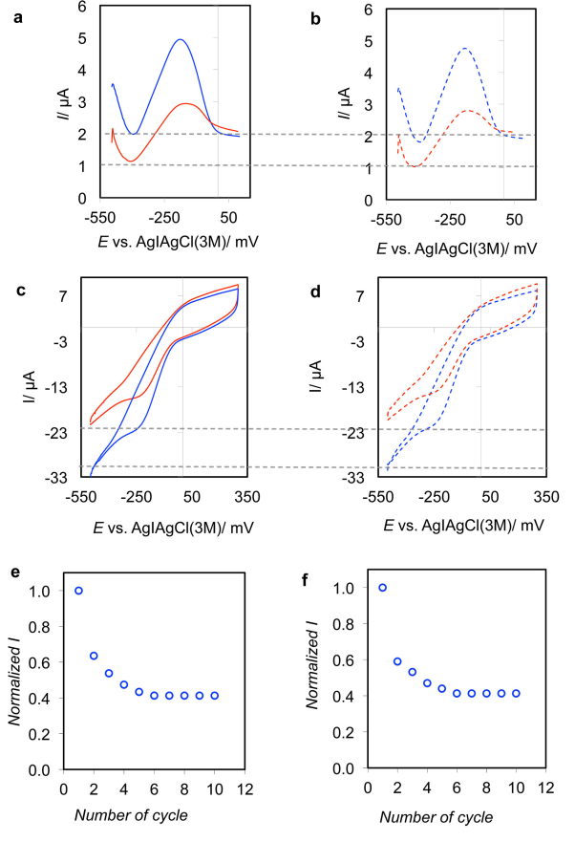
Evaluating Hypothesis 2 (Cont.)
Left column graphs shows result of hybridized portions collected first, followed by unhybridized portions. Right column graphs are from the reverse collection order
Lines show before (blue) and after (red) applying 10 cycle square wave pulse
Observations
Lower signal peaks with increasing number of pulse cycles
Current magnitude independent of collection order
Conjecture: hybridized DNA-Au@MNP are reconfigured closer to electrode surface due to applied electrical pulsing
Notes:
Here are the data from evaluating hypothesis 2.
First column of diagrams are data from one collection order. Second column is data from the other collection order.
Diagram a & b are square wave voltammogram.
Diagram c and d are cyclic wave voltammogram.
Blue lines are measurement before square wave pulsing, red line are after pulsing. The drop in current levels after pulse supports theory of network reconfiguration, and that the reconfiguration somehow increases resistance in the network.
It is also observed that the current magnitudes are independent of collection order. Which is a favorable property since in real experiments nano particles are collected randomly. This property helps with reproducibility of results.
The conjecture is that hybridized nano particles are reconfigured closer to the electrode surface under electric field.
---------
Diagram e & f are normalized peak current from square wave voltammogram vs number of cycles

Slide 23
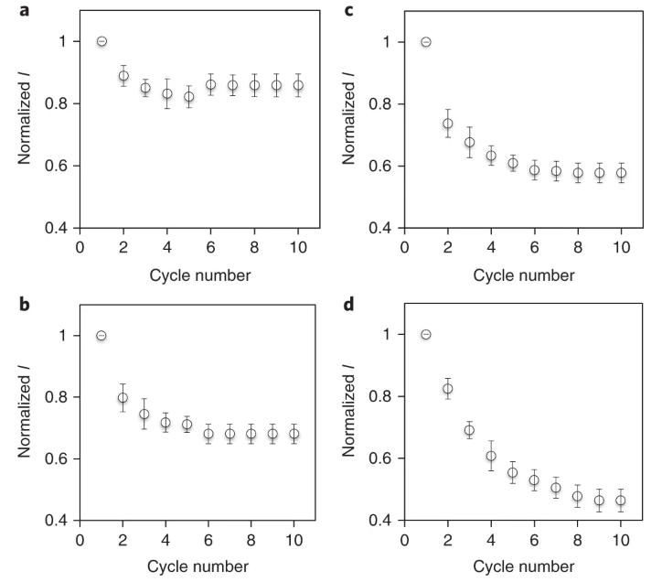
Evaluating Hypothesis 2 (Cont.)
Change in square wave current with cycle number for target concentrations of (a) 0 M, (b) 10 aM, (c) 0.1 pM, (d) 1 nM
Larger target concentration requires more cycles to stabilize current and leads to larger changes in current
electrical-pulsing-induced reconfiguration of DNA–Au@MNPs in the network happens to a greater extent in the presence of hybridized nano particles
Notes:
Paper showed some more plots of normalized current changing with cycle number for various analyte concentrations.
The observation here is that larger analyte concentration requires more cycles for current to stabilize, which could mean that there is a greater extent of nano particle reconfiguration under the presence of greater number of hybridized particles.

Slide 24
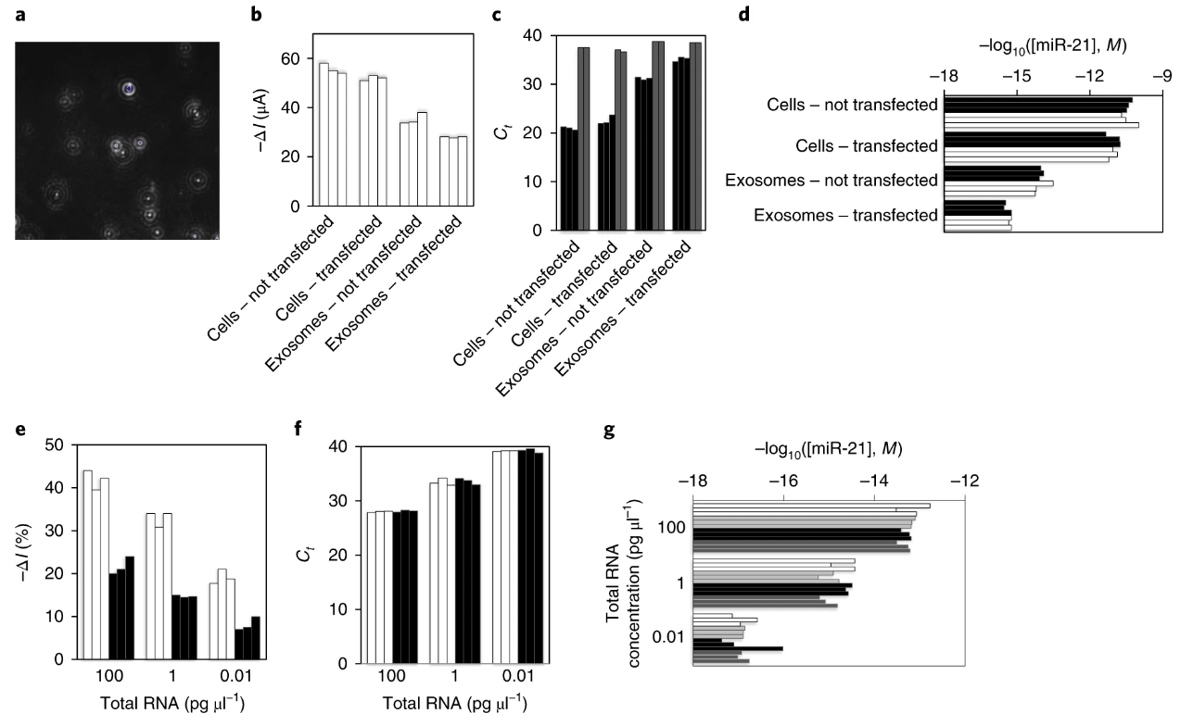
Examining Capability of Sensor
Detection in total RNA extract from human lung cancer cells (A549) and vesicles (exosomes) released by the cells
White bar is assay results in PBS
Light grey is qRT–PCR results in PBS
Black bar is assay results in blood
Dark grey is qRT–PCR results in blood
Notes:
To examine capability of the sensor, clinical samples containing lung cancer cells and vesicles were tested.
Diagram (a) shows image of extracted exosomes of A549 lung cancer cells
For the following diagrams, each bar represents an independent experiment
Diagram (b) shows hybridization induced change in current for A549 cells and exosomes before and after transfecting with miR-21 inhibitor.
Larger change in current correlates to higher concentrations of miR-21.
We can see that transfected samples show a lower current change compared to untransfected samples. This demonstrates ability of the assay to detect small variations of the analyte.
We can also observe that miR-21 expression levels are much lower in exosomes than in cells.
Diagram (c) shows qRT–PCR results for same samples in diagram (b). Black bar is the cycle threshold (Ct), higher means lower concentration of analyte. Grey bar is concentration of miR-39, used for normalization. The observations are consistent with (b).
Diagram (d) is the diagram (c) and (b) put together so its easier to see that both the electrochemical assay and qRT–PCR show agreeable results.
Further experiments were done on varying concentrations of total RNA extract from A549 in blood and PBS. The concentration miR-21 was unknown for these experiments.
Diagram (e) shows the results for the assay. White bar is data from PBS, black bar is data from 50% human blood.
We can see that level of miR-21 detected is lower in blood compared to PBS and that there are distinctive changes in miR-21 concentration.
Diagram (f) shows the results done on the same samples using qRT–PCR.
Diagram (g) puts the result of diagrams (e) and (f) together. White bar is assay results in PBS, black bar is assay results in blood. Light grey is qRT–PCR results in PBS and dark grey is qRT–PCR results in blood.
The electrochemical assay results are consistent with qRT–PCR and it demonstrates that the electrochemical assay can detect miR-21 directly from human blood.
-----------
Vesicles are kind of like a message object, includes miRNA, in cell-to-cell communication

Slide 25
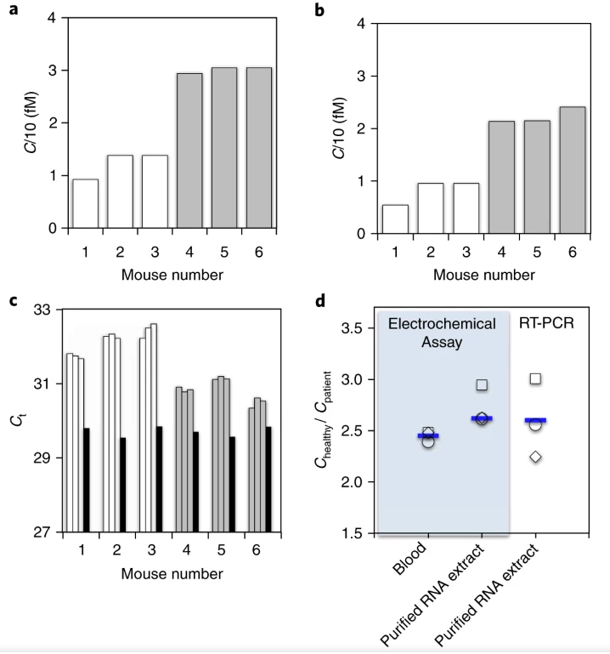
Examining Capability of Sensor (Cont.)
measuring miR-21 expression in whole unprocessed blood in a clinically relevant xenograft mouse model of human lung cancer
3 healthy mice, 3 mice with tumors
(a) electrochemical assay done on whole blood
(b) electrochemical assay done on RNA extract
(c) qRT-PCR done on RNA extract
Notes:
Experiments were also done on mouse models.
The electrochemical assay was performed on whole blood and total RNA extract. Results are shown in diagram (a) and (b) respectively.
Clearly you can see heightened levels of miR-21 in mice with tumor (grey bars).
Diagram (c) shows analysis of qRT-PCR. (A lower cycle threshold means lower concentration of miR-21. Ignore the black bars since it’s normalization data (miR-39))
Diagram (d) summarizes all the data together. It shows the concentration ratio of miR-21 in tumor mouse compared to control. Blue line is the average of ratio.
Two important observations here: first is that the assay result is consistent with RT-PCR. Second is that there is less variations in the concentration ratio calculated from the assay compared to RT-PCR.
Again, this demonstrates that the electrochemical assay can be directly applied to unprocessed blood samples and can give more consistent results with less variations compared to RT-PCR.

Slide 26
Conclusion
Demonstrated direct analysis of miRNA in whole blood with high sensitivity within eight orders of concentration (1 nM–10 aM)
Results were consistent with qRT–PCR (gold standard) and analysis time takes only 30 mins
Device is low-cost
Since output signal is electrical, it is compatible with automation
Future work: the sensing concept could be tested for different biomarkers such as circulating DNA, or protein

Slide 27
Opinions?
Have not explained why reconfiguration of nanoparticle network occurs
Does network reconfiguration depend on properties of the probe/biomarker?
Was evidence of reconfiguration also present when testing the generality of hypothesis 1?
Would like to see more tests on selectivity
single base pair mismatch near 3’ or 5’ end
perhaps location of mismatch affect flexibility, thus impacting electron tunneling through network
Also, 9% difference in current between fully complementary target and near-complementary target seems like a narrow gap
Would like to see study on relationship between DNA probe length and sensitivity of the sensor
hypothesis: probe length positively correlate with sensitivity

Slide 28
References
[1] https://biomarkerres.biomedcentral.com/articles/10.1186/s40364-021-00272-1#Tab2
[2] https://pubs.acs.org/doi/10.1021/cm8025329
[3] https://onlinelibrary.wiley.com/doi/epdf/10.1002/anie.201202350

Slide 29
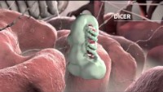
Gene Silencing by MicroRNA

